Slide 1
Intro to Windows
Anika Karpurapu

Slide 2
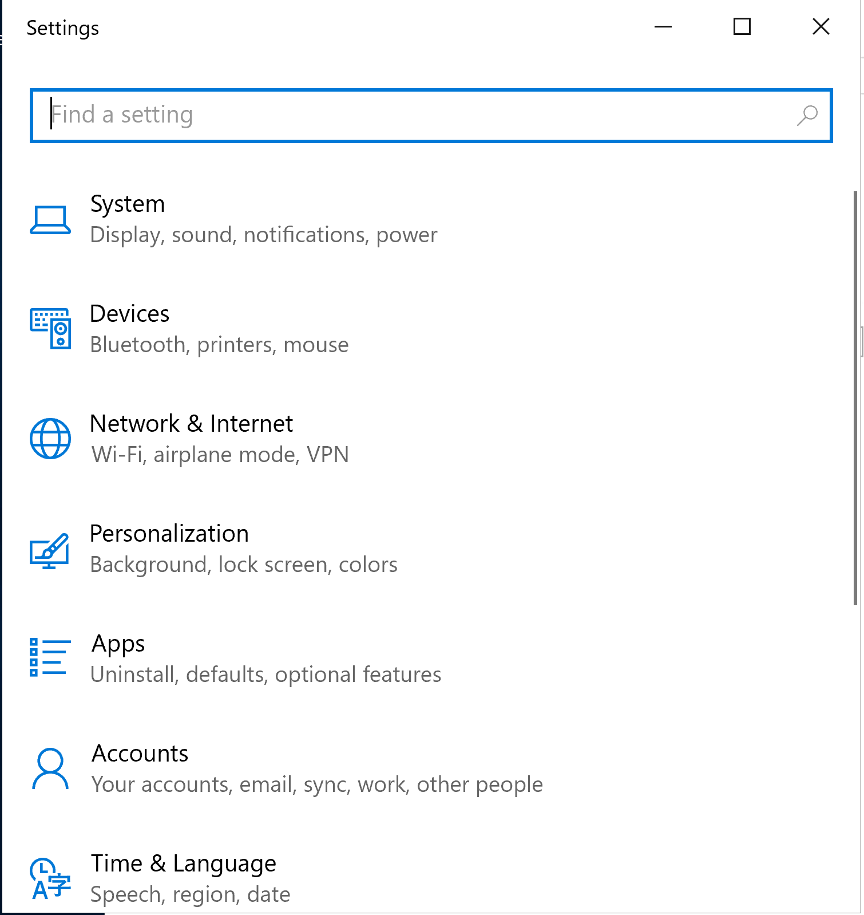
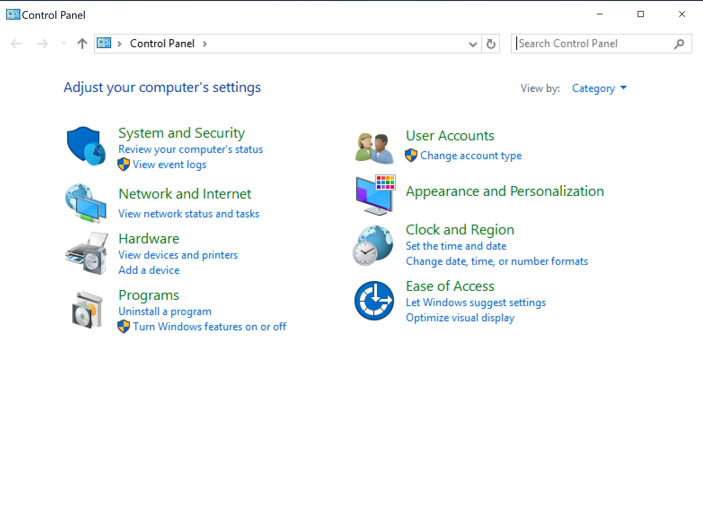
GUI
Almost everything can be found with a simple search, or through settings and control panel

Slide 3
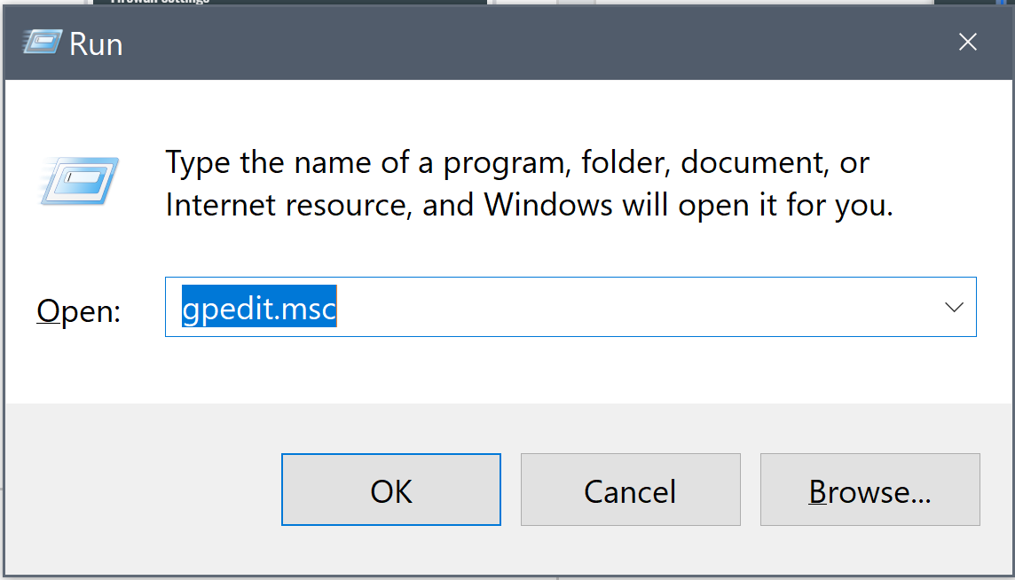
.msc
Press windows key + r
lusrmgr.msc
Local users and groups
gpedit.msc
Local group policy
secpol.msc
Local security policy
taskschd.msc
Automatic task scheduler

Slide 4
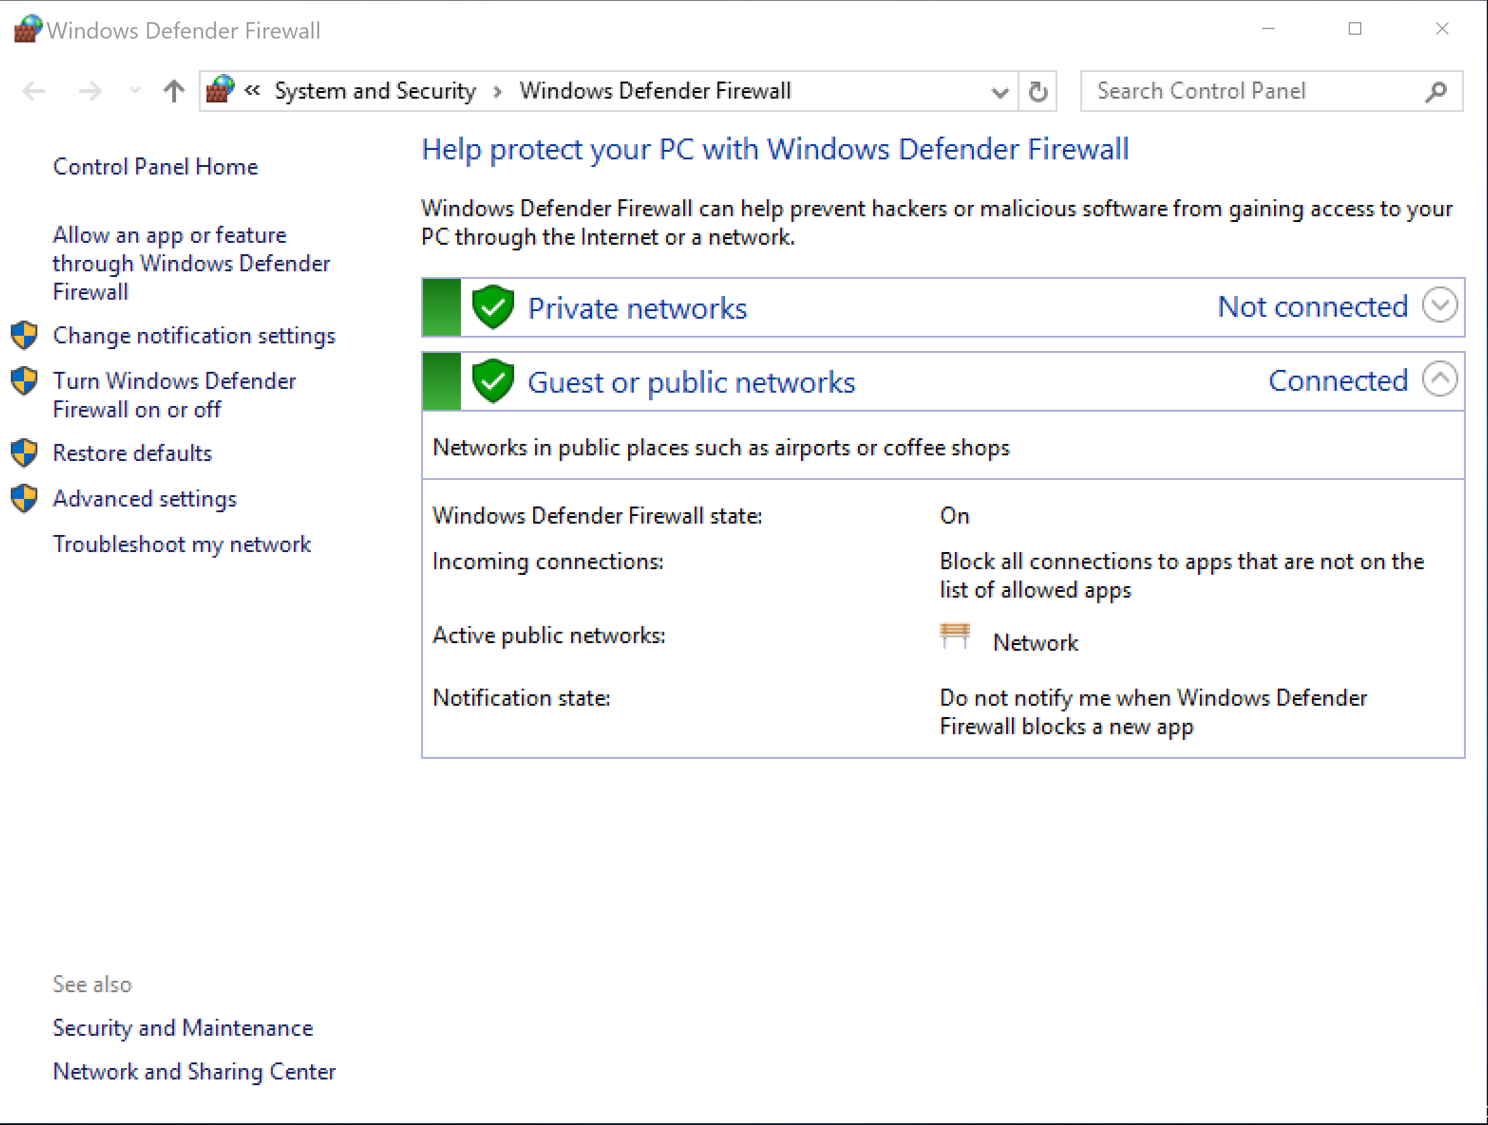
Firewall
Control panel → System and Security → Windows Defender Firewall
Always make sure firewall is on

Slide 5
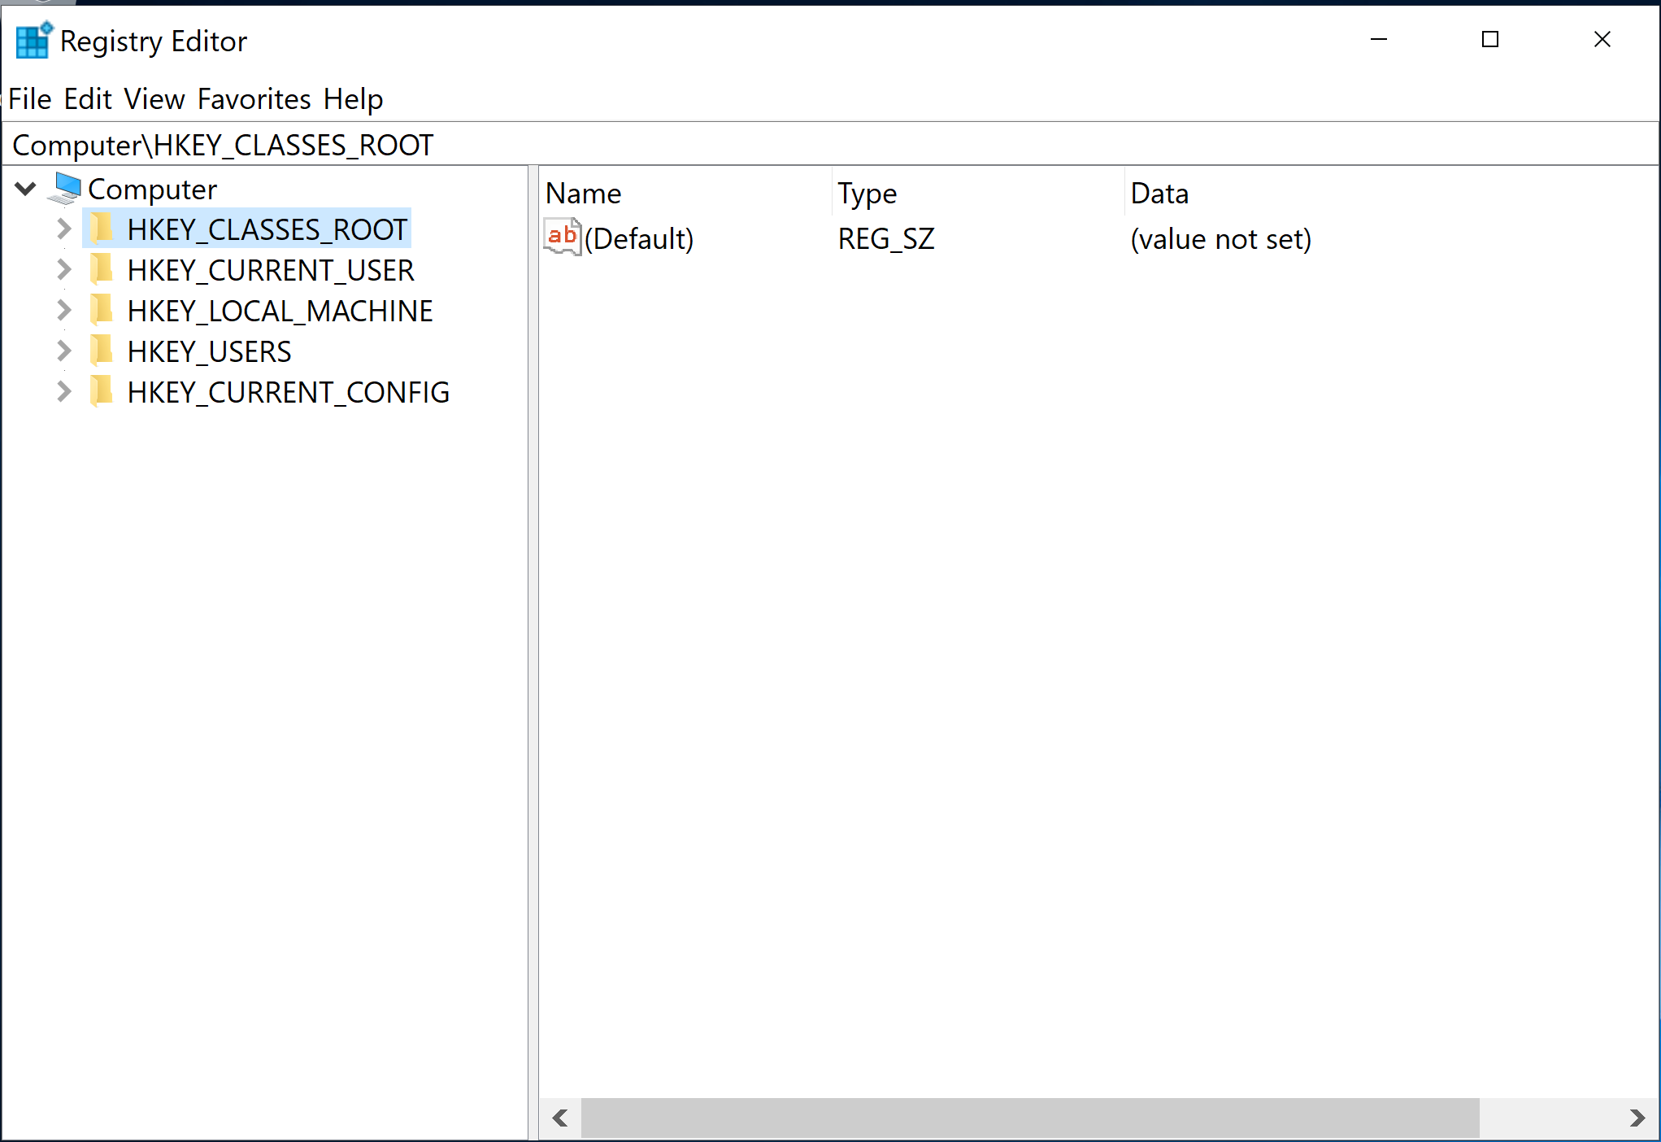
Windows Registry
HKEY_CLASSES_ROOT
File association and sharing information
HKEY_CURRENT_USER
Settings and config for current user
HKEY_LOCAL_MACHINE
Stores settings specific to local computer
HKEY_USERS
Settings and config for all users
HKEY_CURRENT_CONFIG
Hardware information

Slide 6
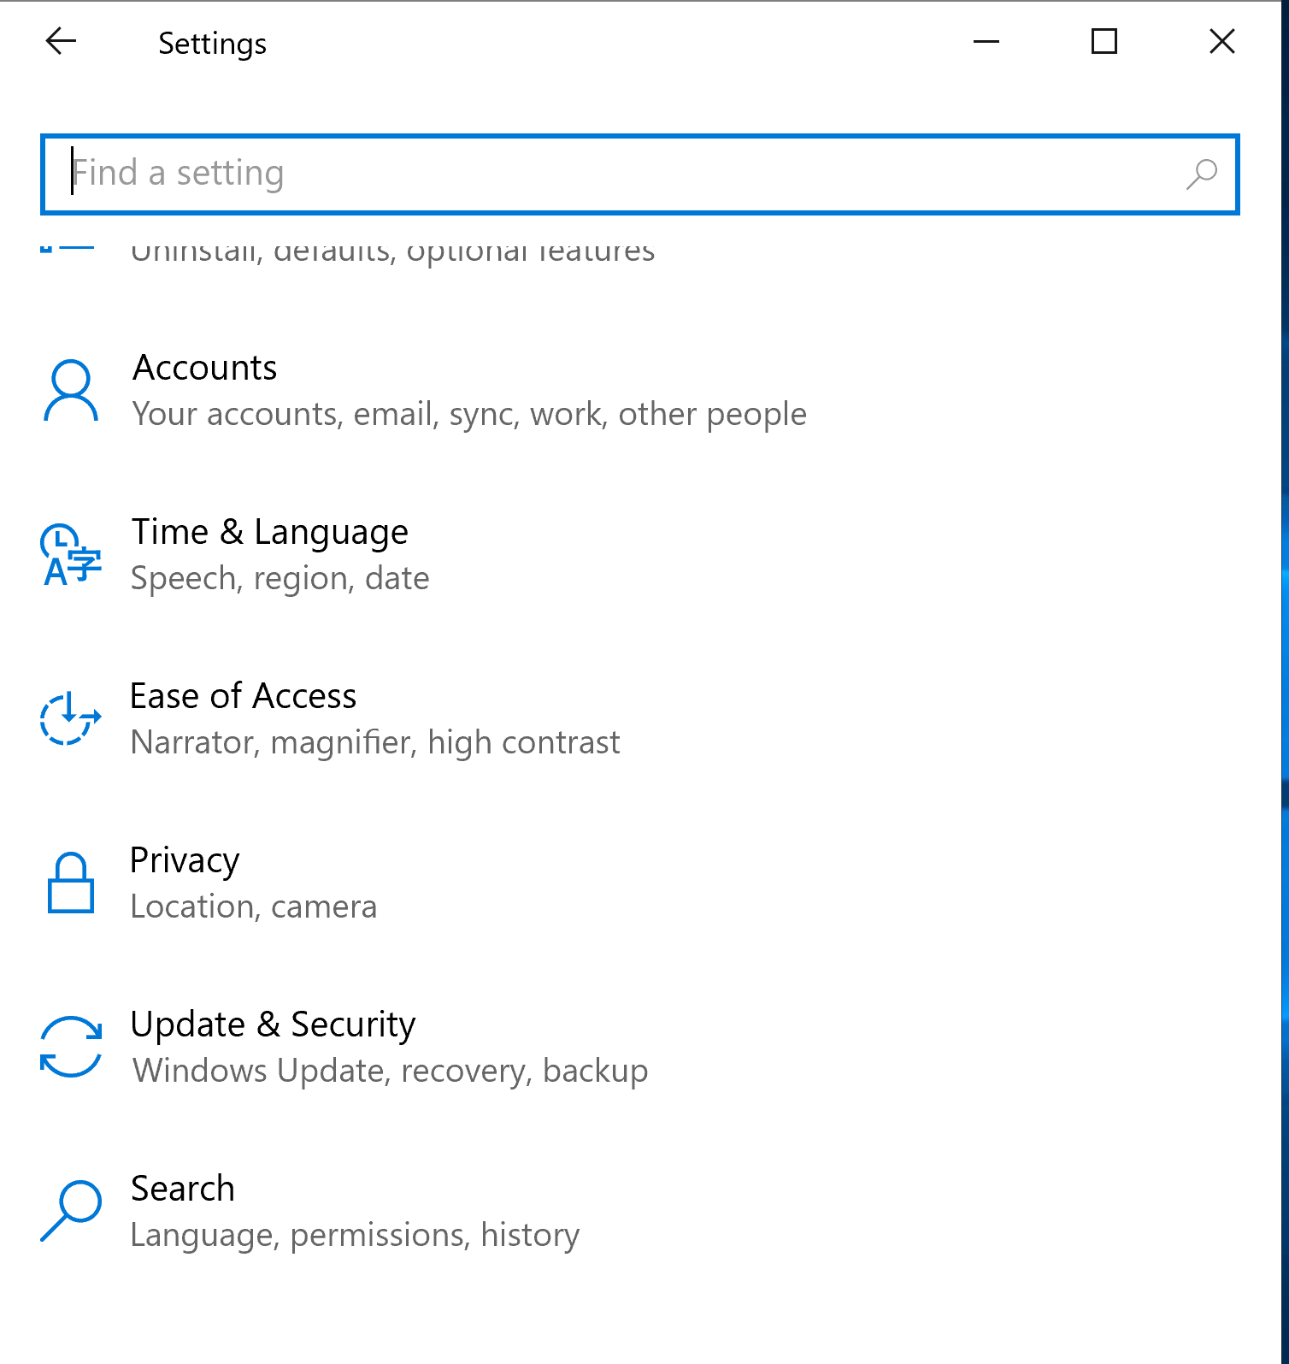
Windows Updates
Update VM at the beginning of the competition

Slide 7
Command Prompt (cmd.exe) Basic Commands
cd: change directory
dir: lists all the files in the directory
mkdir: creates a new directory
ren: rename file
copy: copy file
move: moves file
del: delete file
cls: clear your screen
launch an application (e.g. mspaint.exe)
help: will list out all the commands and what they do
*Run as administrator on opening

Slide 8
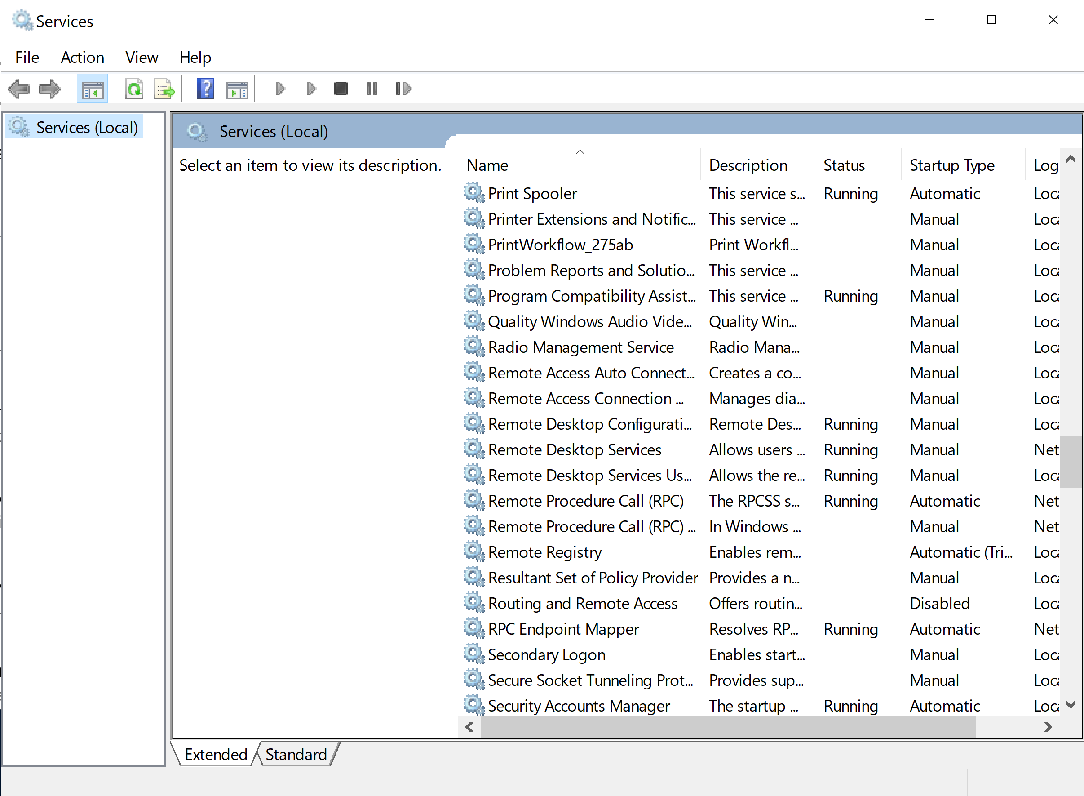
Remote Desktop Settings
Allows users to connect to a device remotely -- unsafe
Disable them unless otherwise specified

Slide 9
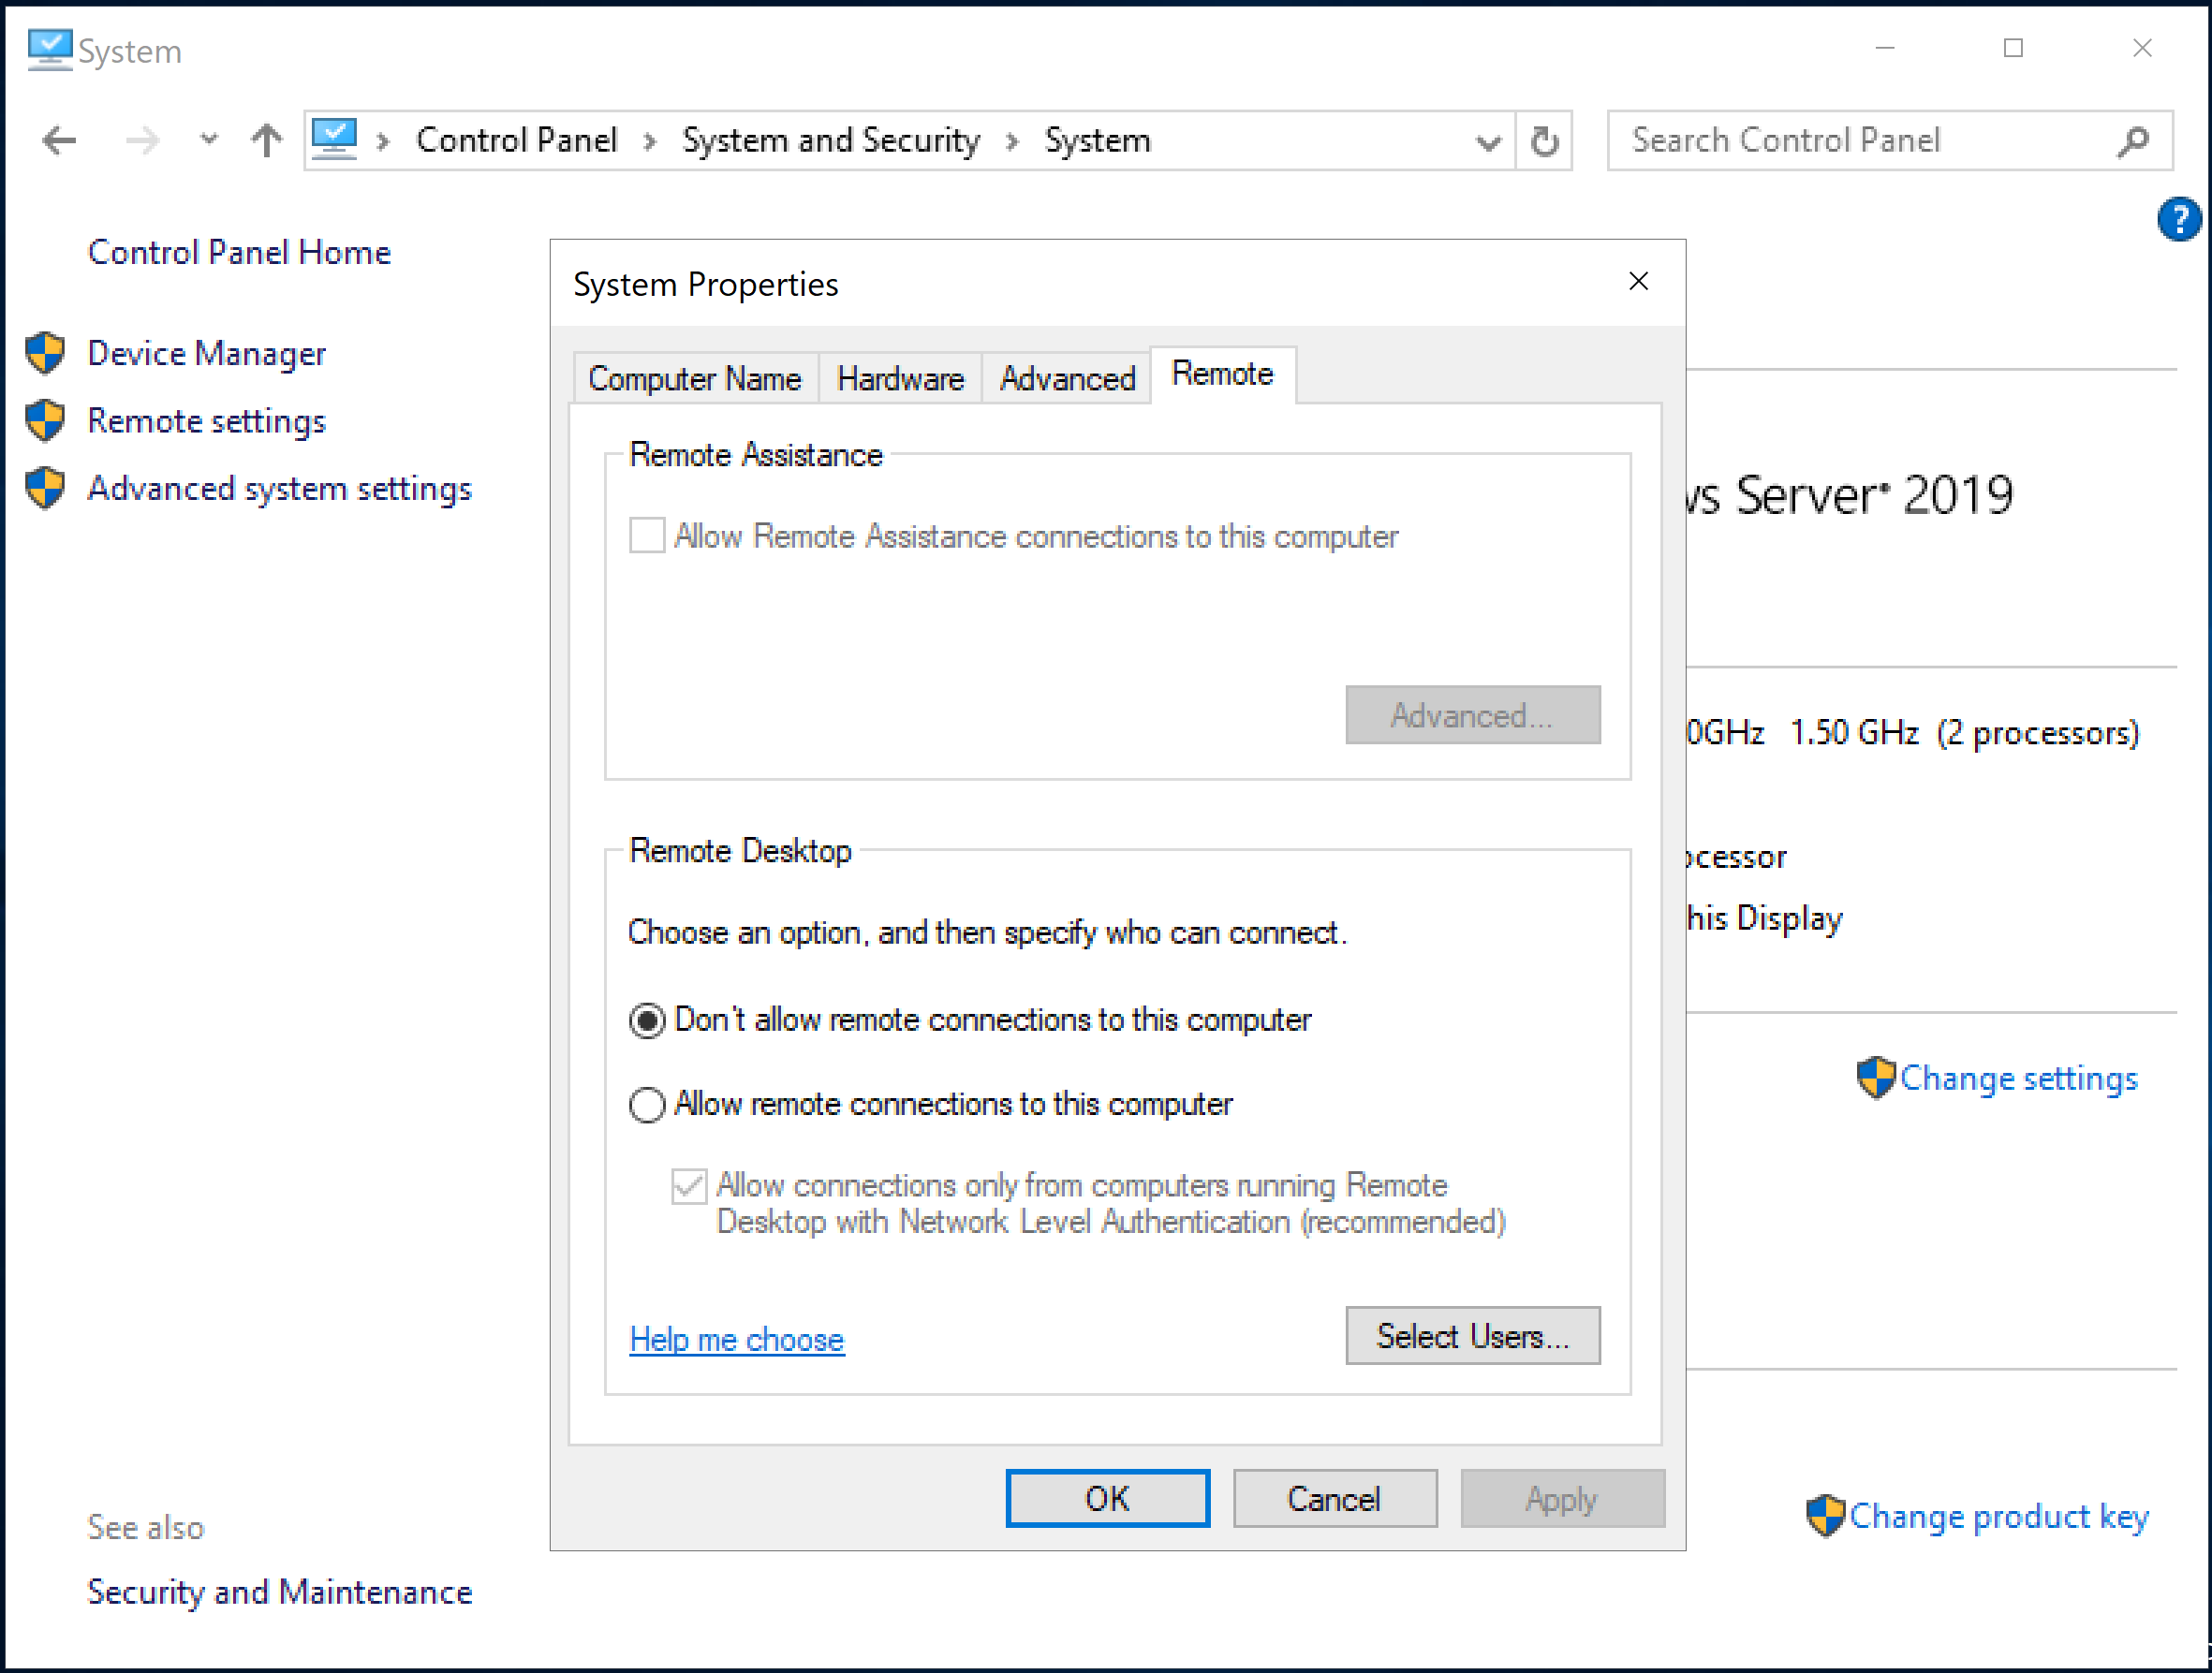
Remote Desktop Cont’d
Control panel → System and Security → System → Advanced System Settings → Remote tab
OR
Control panel → search for remote → click on System → Remote Settings

Slide 10
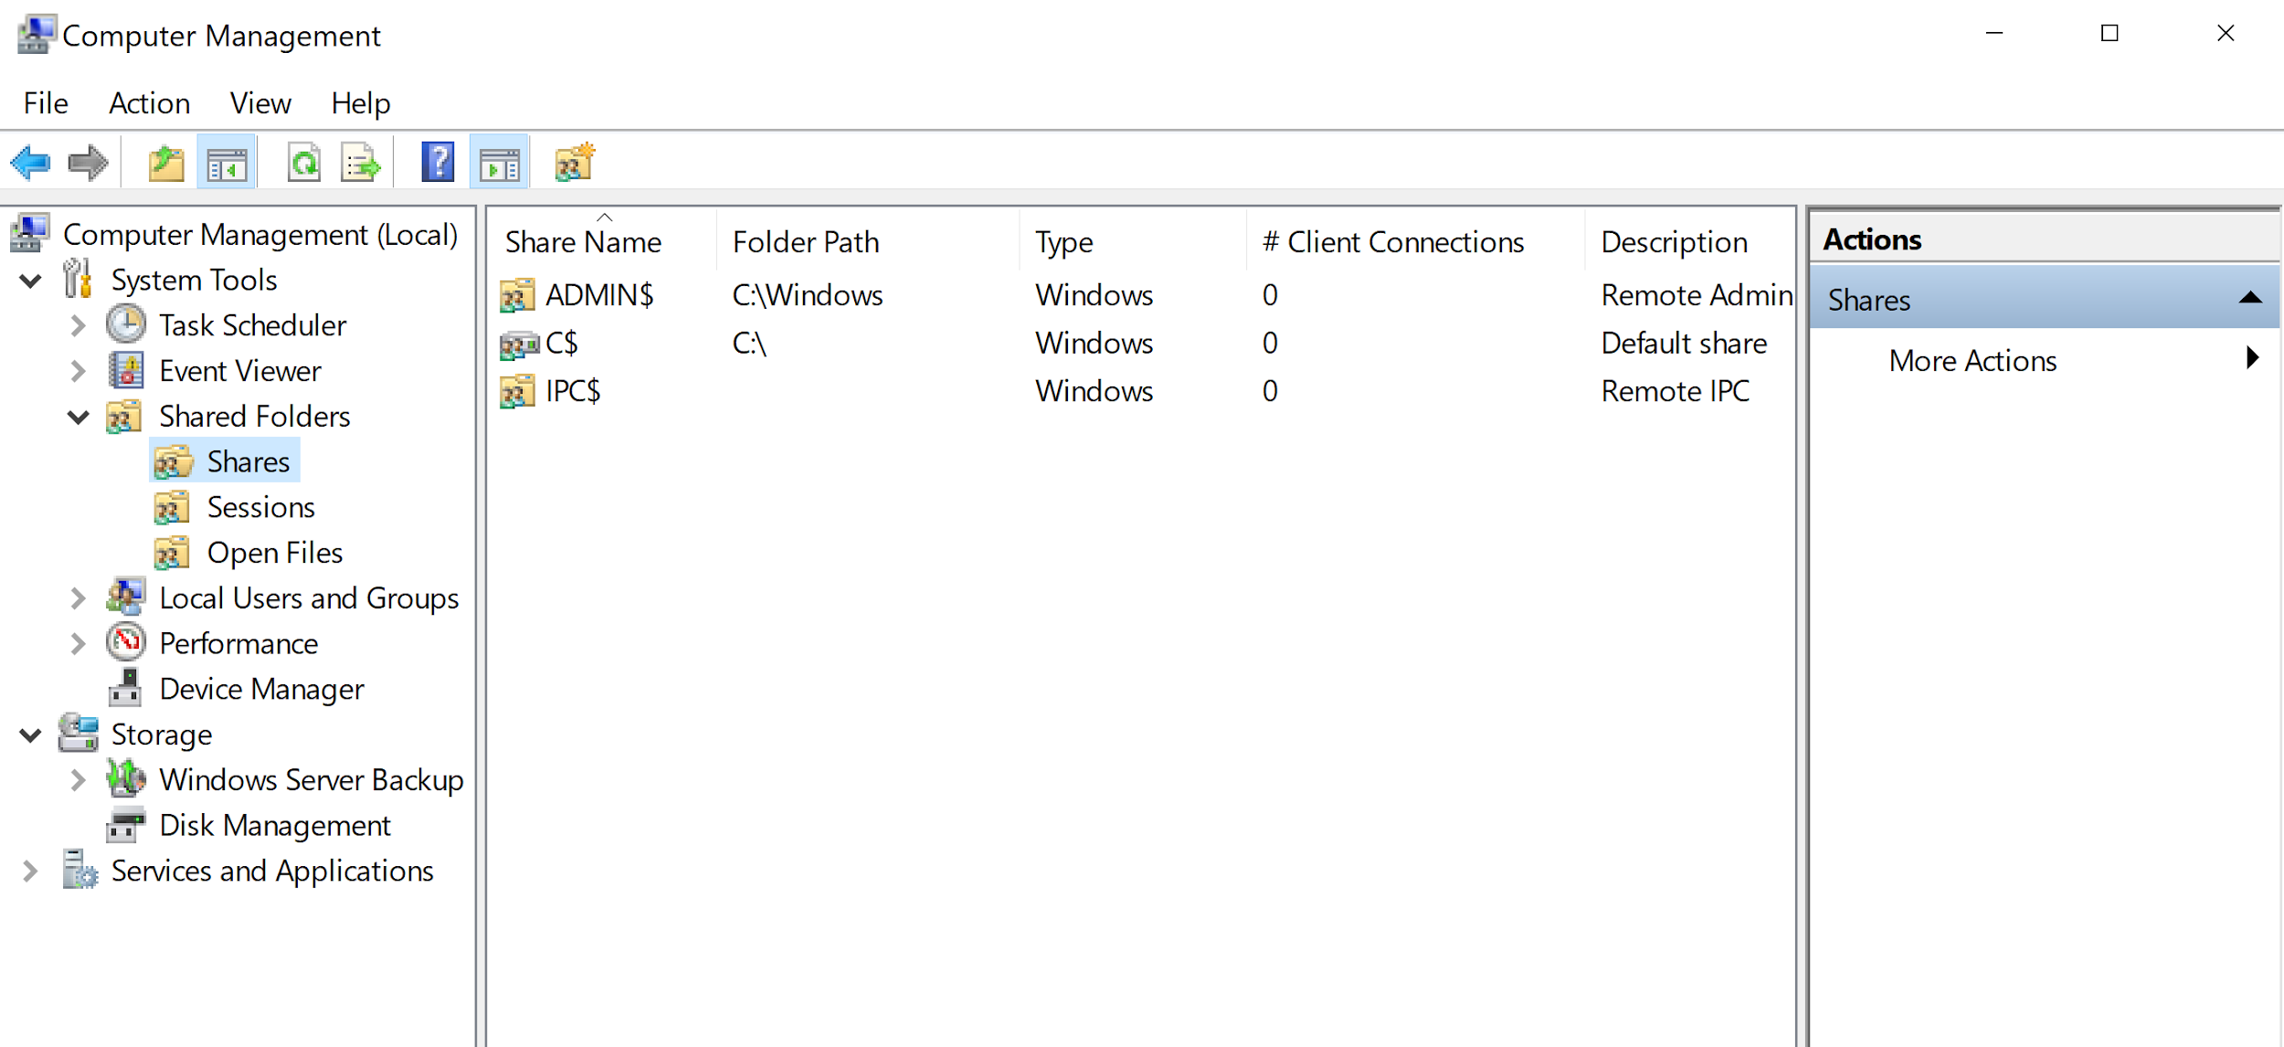
Net Shares
Command prompt
compmgmt.msc

Slide 11
VM setup demo!

